Slide 1

FP2020
NATIONAL PREPARDNESS & THE FAMILY PLANNING AGENDA
July 21, IAS 2019, Mexico City
FAMILYPLANNING.ORG
#FP2020PROGRESS
@FP2020 GLOBAL
FACEBOOK.COM/FAMILYPLANNING2020

Slide 2
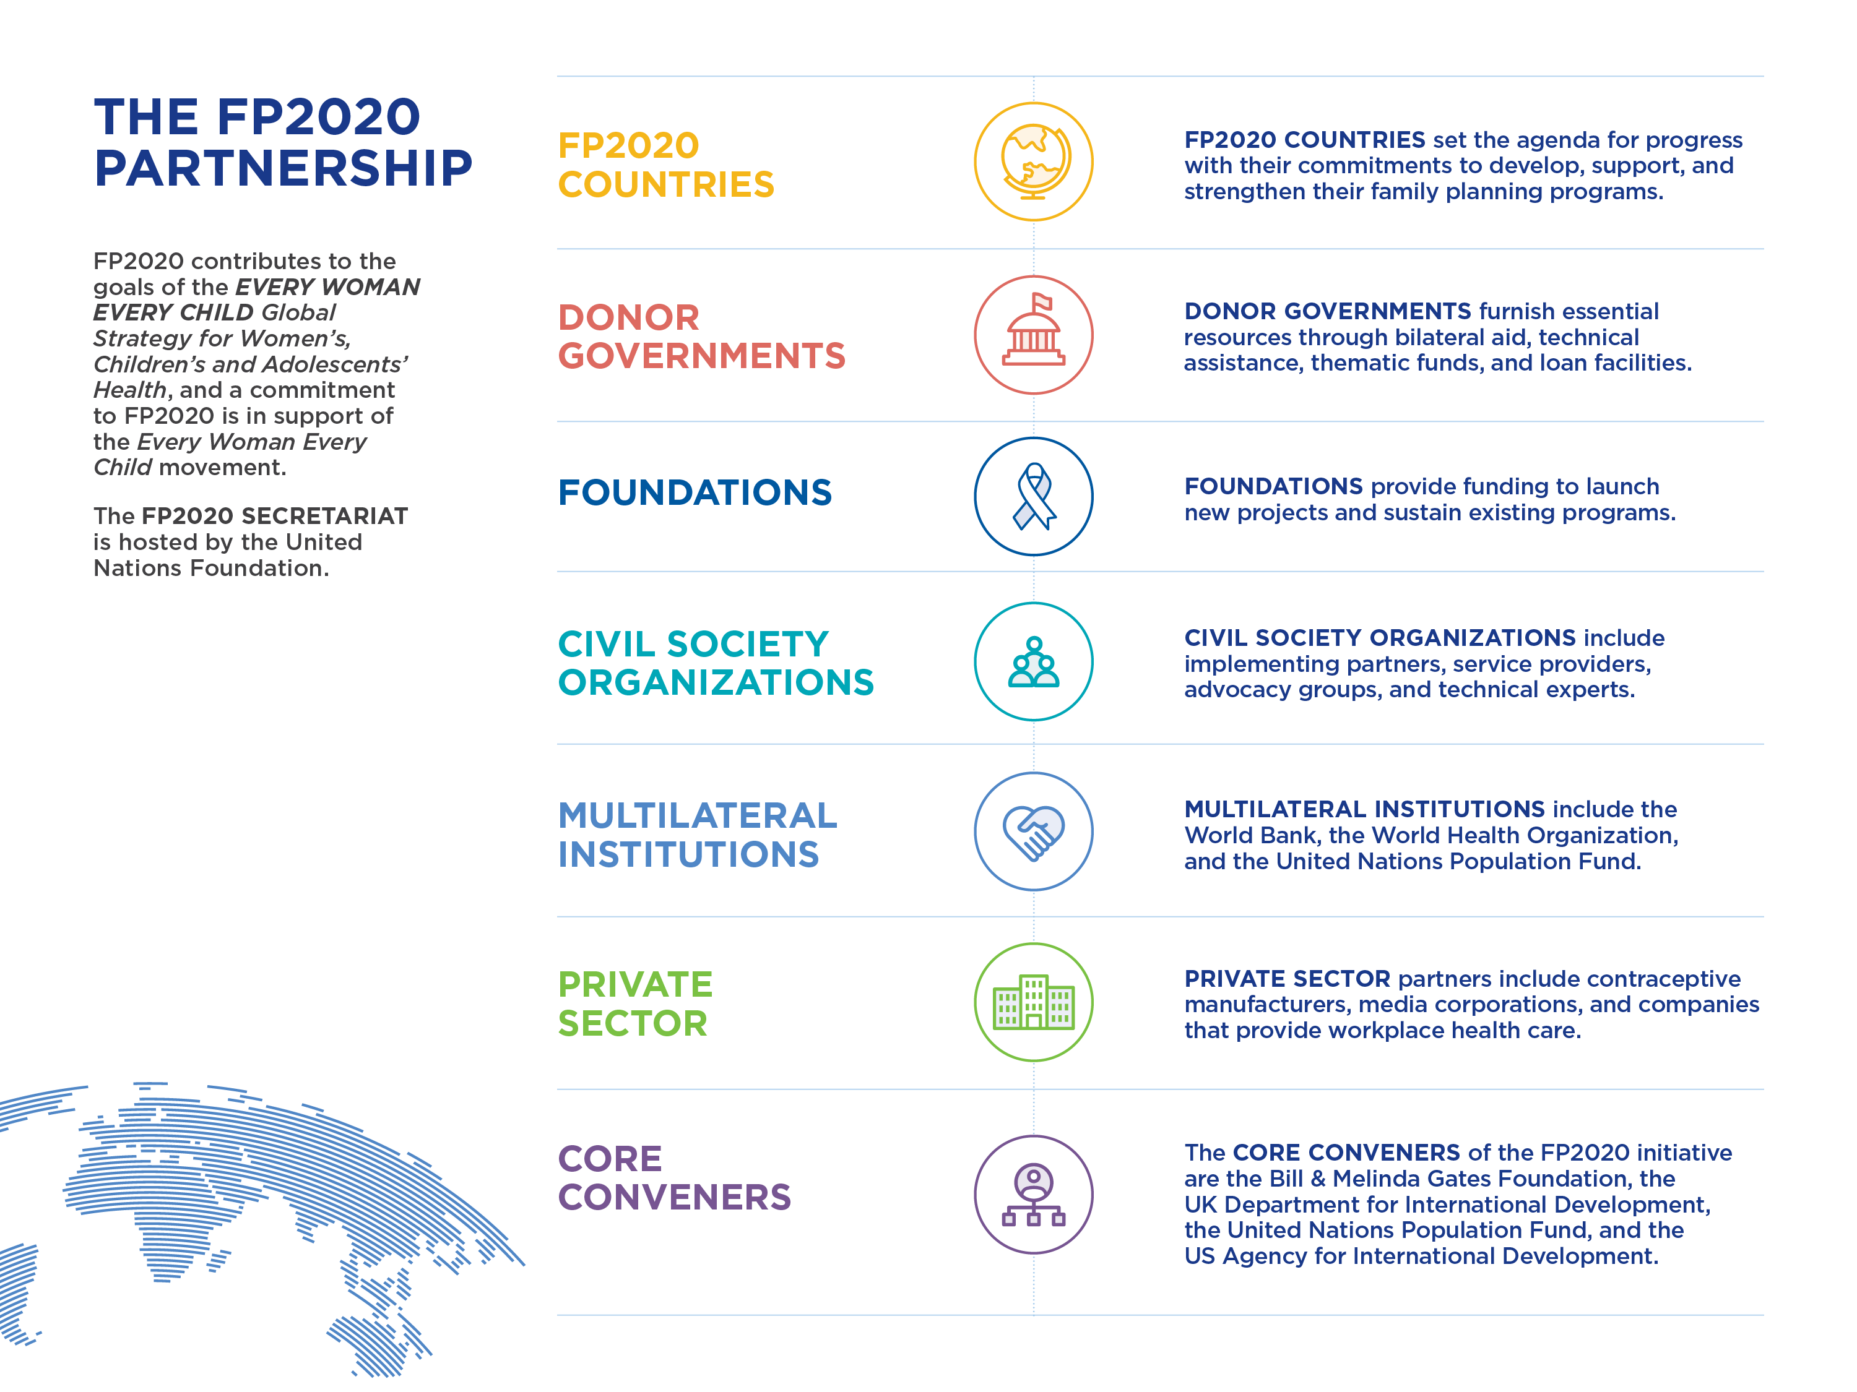
Notes:
Who is Family Planning 2020?
FP2020 is a global community of partners working together to advance rights-based family planning. The FP2020 partnership was launched at the 2012 London Summit on Family Planning with the goal of enabling 120 million additional women and girls in 69 of the world’s lowest-income countries to use voluntary modern contraception by 2020.
In the FP2020 approach, countries lead the way. They set the agenda for progress with formal commitments to develop, support, and strengthen their family planning programs. Each country’s commitment functions as a blueprint for collaboration, providing partners with a shared agenda and measurable goals.

Slide 3
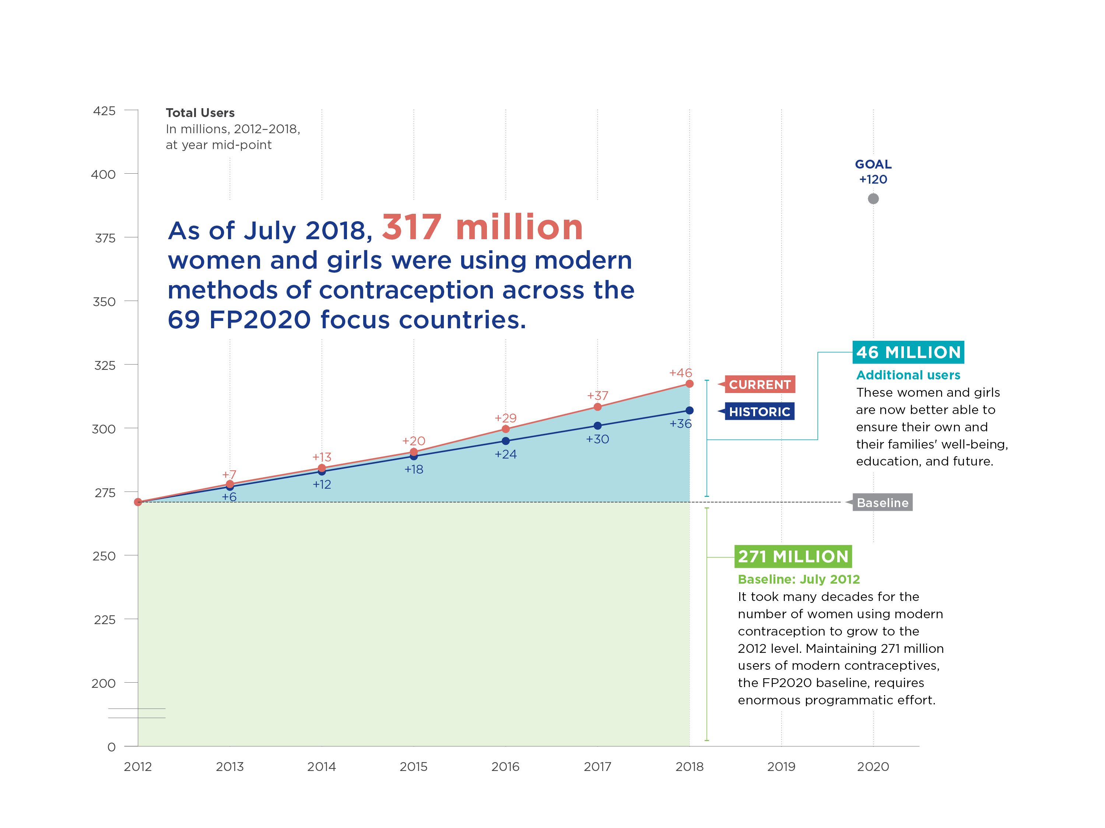

Slide 4
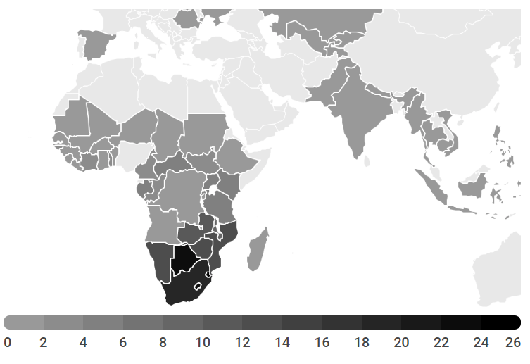
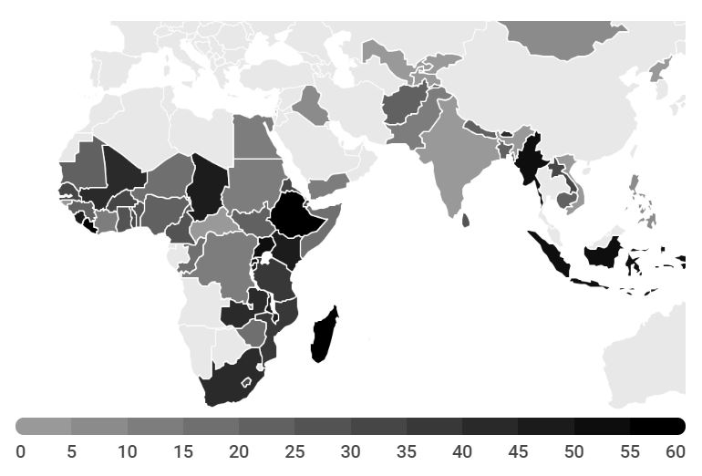
MAPPING HIV PREVALENCE & INJECTABLE USE
HIV PREVALENCE
INJECTABLES USE
Notes:
Injectable data is from FP2020 (method mix), HIV data is UNAIDS
Three major takeaways:
Nearly a third of all FP users in FP2020 countries use injectables, implants, or IUDs (FYI: 98 million/317 million – 2018 Progress Report).
In 2018, over 98 million women were using injectables, implants, or IUDs in FP2020 countries (including South Africa). Among these, the majority were using injectables, followed by IUDs and implants.
Over 55 million were using injectables;
Over 11 million were using implants; and
Over 31 million were using IUDs.
In 37 FP2020 countries, either implants, injectables, or IUDs are the dominant method. In 27 of these 37 countries, injectables is the dominant method.
Clients have a right to reliable access to the broadest possible choice of contraceptive methods and a full suite of reproductive care. However, there is a large skew towards injectables in high HIV prevalence countries.
Among the 37 countries where implants, injectables, or IUDs are the dominant method, 4 countries (excluding South Africa) have high HIV prevalence – above 5% -- these countries are Kenya, Malawi, Uganda, and Zambia.
Within these countries there are large differences in use, and injectables are the most dominant.
In Uganda, injectables represent over 50% of the method mix. It has a HIV prevalence of ~7% (2017 UNAIDS) and an unmet need of over 20% (2016 DHS)- more can be done to improve HIV and FP integrated services that strengthen informed choice.
Injectables: 1.4K | Implants: 480K | IUDs: 113K
Other examples:
Zambia (HIV prevalence 14.3)
Injectables: 600K | Implants: 195K | IUDs: 42K (2017 UNAIDS)
Unmet need: 16.7% (2013-14 DHS)
Malawi (HIV prevalence 11.7)
Injectables: 1M | Implants: 429K | IUDs: 38K (2017 UNAIDS)
Unmet need: 15.1 % (2015-16 DHS)
Kenya (HIV prevalence 6.2)
Injectables: 2.6M | Implants: 1M | IUDs: 328K (2017 UNAIDS)
Unmet need: 12.8% (2014 DHS)
HIV Incidence also high in pregnancy.
The incidence of HIV is high regardless of method group (injectable, implant, or IUD). This is true, but recent research conducted in a similar population as ECHO indicates that HIV acquisition is also high in pregnancy and during the postpartum period. Depending on a woman’s gestational age or postpartum status, incidence of HIV acquisition is between 3.75 to 7.02 per women-years. Note, while this is this just one paper, there are additional publications to corroborate this evidence

Slide 5
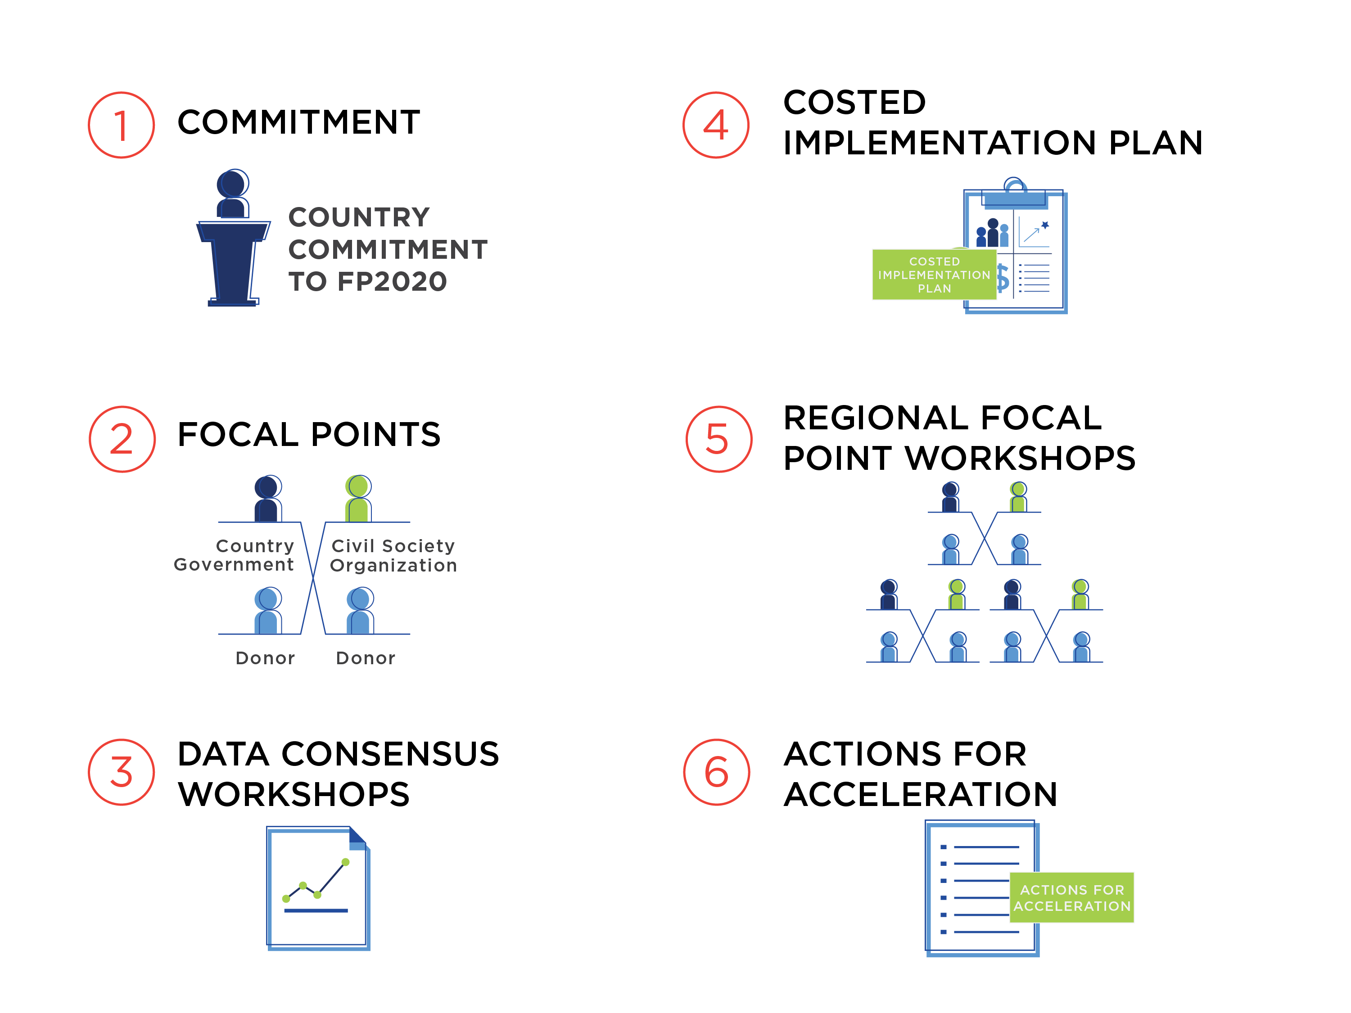
HOW FP2020 WORKS
A country-led approach to developing rights-based family planning
programs that are sustainable, accountable, and supported by
^{data and evidence}
Youth
Notes:
Focal Point structure: FP2020 Focal Points in each commitment-making country are individuals representing the government, donor agencies, civil society, and youth. The focal points serve as the key representatives of the FP2020 movement in-country. They coordinate with each other, the government, other partners and stakeholders, and the FP2020 Secretariat to drive progress on the country’s family planning goals.
How we engaged the Focal Point community and broader FP community to prep for ECHO:
ECHO focus at Regional Focal Point Workshops over the last 18 months.
Worked closely with countries on their preparedness for ECHO, many countries setting up National Task Forces (along the lines of Kenya and Zambia models) and ensured had support in terms of messaging & coms strategy including scenarios, workplans, and several of these ToR contained Id opportunities sustainable str of of integration of SRH/FP and HIV.
In April, the Secretariat convened FP and HC-HIV advocates in Washington, DC to prepare for the potential impact of ECHO trial results. HC-HIV and FP partners from Kenya, Tanzania, South Africa, Uganda, and Malawi participated to share country-level perspectives particularly from women living with HIV/AIDS and youth.
Reference Group of FP2020 (7 ministers, donors, CSO, chris and Natalia) – special ECHO Session jointly presented by Ian Askew of wHO and GoK on preparedness efforts.
The Secretariat continuously shared resources and messages with the global FP CSO community, including through the RHSC advocacy and accountability working group, and presenting at an Advance Family Planning partners meeting in Mumbai.
In the lead up to the results, we convened biweekly coordination calls with WHO, USAID, AVAC, and BMGF to share information and coordinate preparation and messaging efforts, and we continued coordinating meetings of communications experts from the HIV and FP communities.
Additionally, in collaboration with WHO and AVAC, the Secretariat hosted a series of webinars on how to prepare for ECHO, understanding the results, and resources for the global community.

Slide 6

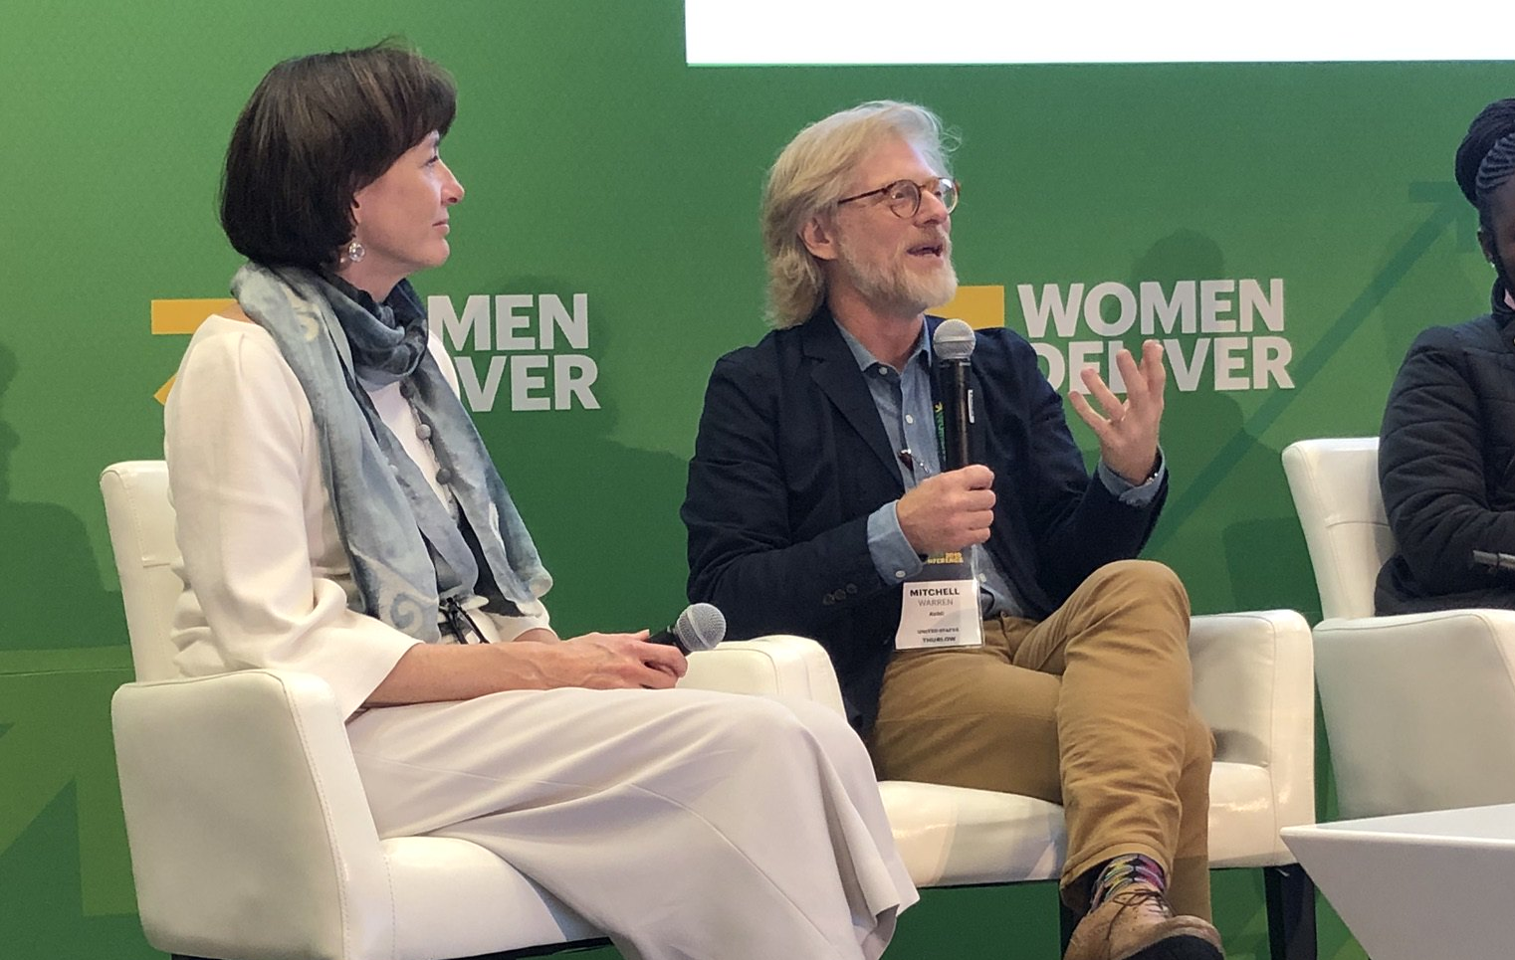

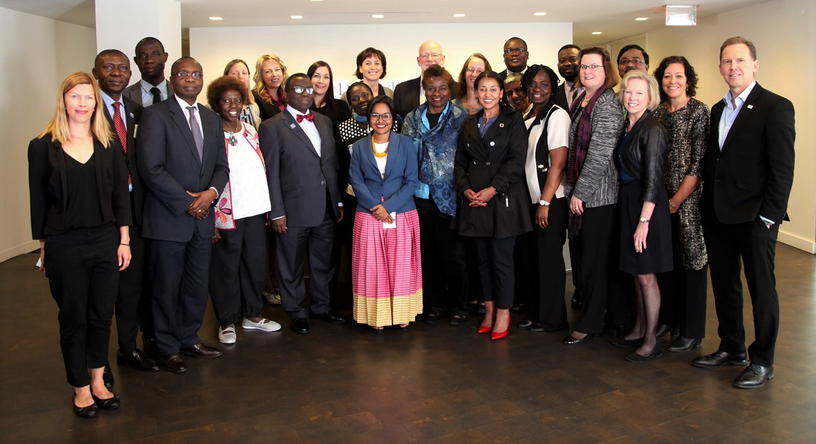
PROGRESS IN PARTNERSHIP
FOCAL POINT WORKSHOPS
AVAC/FP2020
PARTNERSHIP
ECHO
WEBINAR SERIES
FP2020
REFERENCE GROUP
Notes:
The way the Secretariat, and indeed the broader FP community, talks about integration now is radically different than it was a year ago. We’ve incorporated the ECHO study and findings, and integration more broadly, into our work at every level – at key FP2020 moments like Focal Point Workshops and Reference Group meetings as well as global convenings like Women Deliver. As we move beyond 2020, it is another chance to improve our partnership with the HIV community.

Slide 7

ECHO, MOVING FORWARD
Client-centered, rights-based programs
^{Full and informed choice}
^{Integrated services}
^{Focus on adolescents and youth}
Photo Credit: Images of Empowerment
NATIONAL PREPAREDNESS AND THE FAMILY PLANNING AGENDA
Notes:
Client-centered, rights-based programs:
Women and girls’ rights, needs and preferences, rather than services, methods, systems or funding, should be the programmatic drivers.
Women and girls themselves should participate meaningfully in designing and monitoring programs intended to serve them.
All actors in reproductive health (men and boys, women and girls, service providers) need literacy training so they can better understand their role in respecting, protecting, and fulfilling individuals’ human rights in regards to sexual health.
Full and informed choice:
Clients have a right to reliable access to the broadest possible choice of contraceptive methods, including short and long acting methods, permanent methods, and more. Unfortunately, the ECHO trial showed many FP programs across sub-Saharan Africa are skewed toward Depo, denying women full and informed choice among a broad mix of contraceptive methods.
They also have a right to quality counseling that ensures clients know the risks and benefits of all methods, that addresses the management of common side-effects, that assesses the client’s risk of HIV and other STIs and need for dual/ triple protection is essential.
In the push for new or revitalized methods, condoms cannot be pushed aside.
We must enlist young people in messaging guidance on how to make condoms sexy again.
Condom use could be used as a marker for the empowerment of women and the engagement of men.
Integrated standard of care:
Integrating FP information, referral, and services as well as into social and behavioral change programs into HIV, RMNCH, postpartum, post-abortion and GBV programs- and vice versa- offers efficiencies and increases service access.
Integrated care treats clients as whole people with multiple needs and expands the opportunities to identify and meet those needs holistically.
Full service integration is a complex undertaking and may have to be realized progressively, depending on the specific program and resource context.
Focus on youth and adolescent girls:
Young women are at risk for both HIV and unintended pregnancy.
Segmentation of young clients into specific groups (defined by age, marital status, whether they’re a student) is crucial for identifying and addressing varied needs.
Adolescents need comprehensive sexual education, so they can make their own decisions are contraception and sexual health.

Slide 8
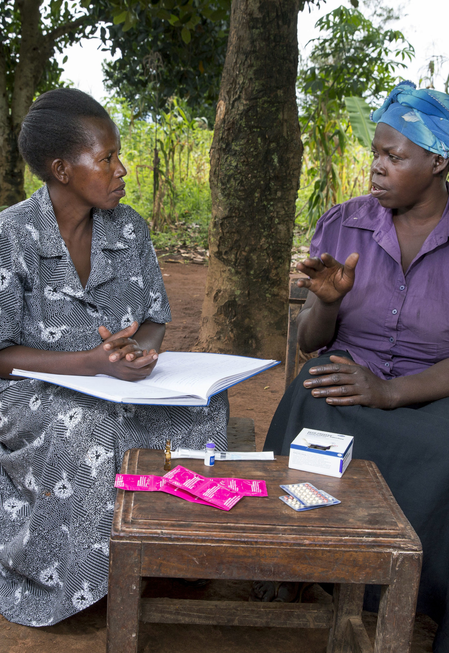
FP2020 COMMITS TO…
Include integration at focal point workshops, and work with countries to ensure clear prioritized actions are set out
Ensure integration is a central focus in meetings with donors and implementing partners as well as with young people and CSOs.
Including integration on the agenda for Reference Group meetings
Adding an integration module into the CIP toolkit.
Notes:
Going forward, FP2020 commits to:
Include integration at focal point workshops, and disseminate information through focal points channels.
Ensure integration is a topic for discussion in meetings with donors and implementing partners as well as with young people and CSOs.
Including integration on the agenda for Reference Group meetings (the April meeting focused specifically on ECHO, so a broader integration conversation is a logical follow-up); and
Adding an integration module into the CIP toolkit.
Shifting ECHO landing page to focus on integration

Slide 9
FURTHER RESOURCES
^{Please visit:}
www.familyplanning2020.org/echo
www.familyplanning2020.org/beyond2020
NATIONAL PREPAREDNESS AND THE FAMILY PLANNING AGENDA

Slide 10

THANK YOU
NATIONAL PREPAREDNESS AND THE FAMILY PLANNING AGENDA
Notes:
Q&A and closing remarks

